Slide 1
How the Earth's Temperature Effect Cyclonic Storms

Slide 2
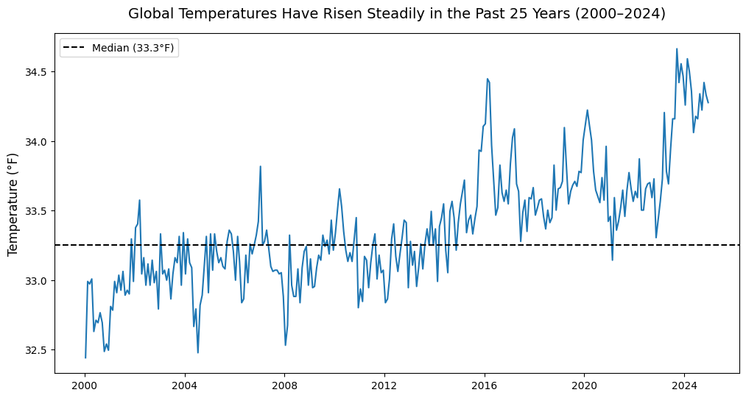
Global Temperatures
Earth has steadily warmed over the last twenty-five years. Does it effect how often or how severe storms become?

Slide 3
With the gradual rise in Northern Hemisphere temperatures, it suggests a potential connection between warming conditions and increased storm strength.

Slide 4
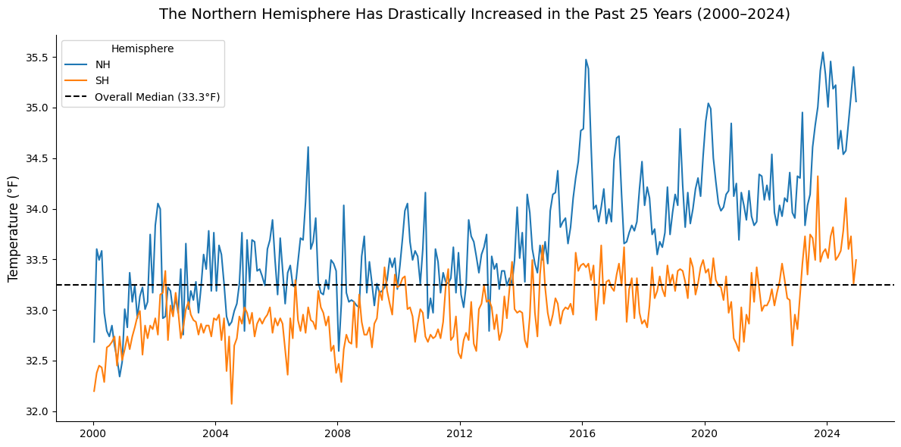
Northern vs Southern Hemisphere Temperatures
The Northern Hemisphere has been warming up drastically faster.

Slide 5
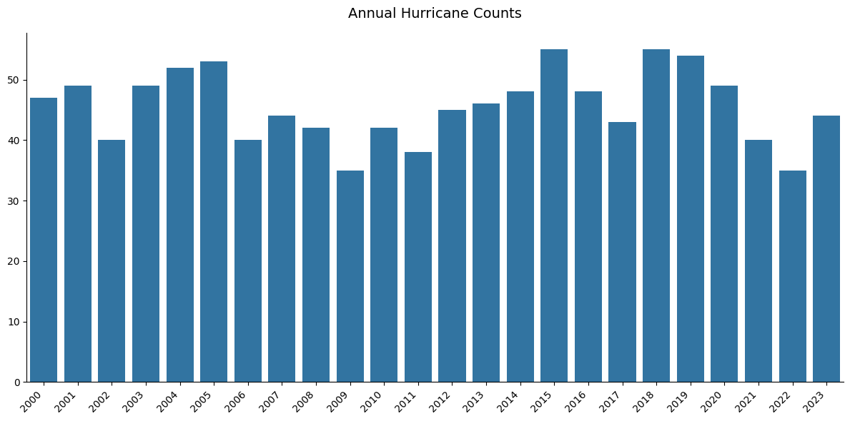
Hurricane Counts
Total numbers rise and fall but do not consistently go up.

Slide 6
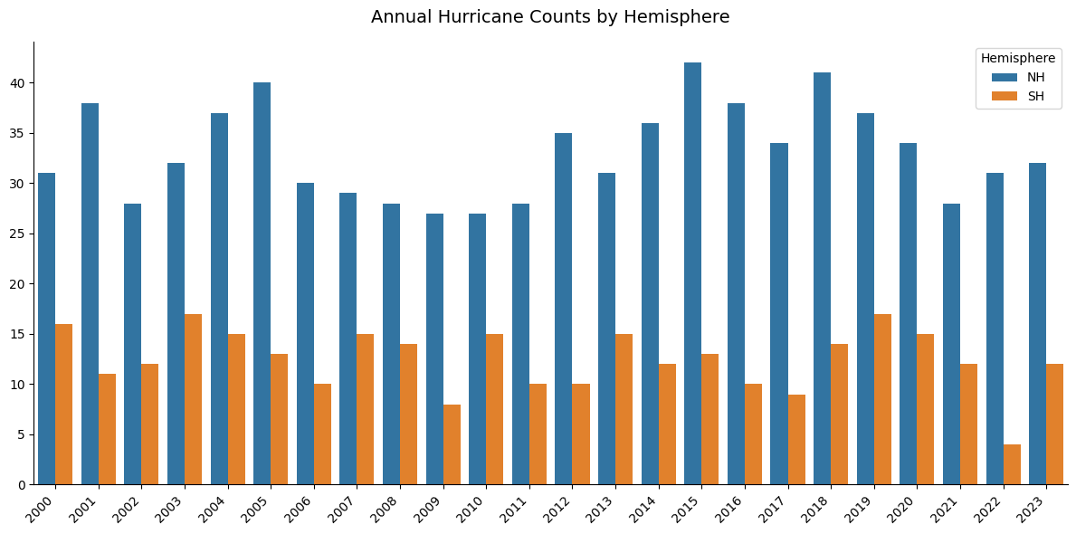
Where Hurricanes Happen
Most hurricanes occur in the Northern Hemisphere.

Slide 7
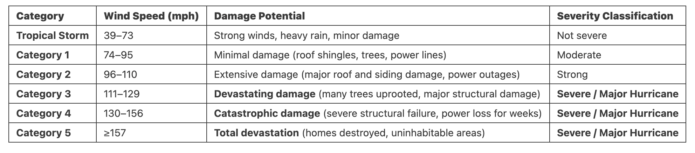
Hurricane Classifications
Hurricanes categorized as Category 3 or higher are generally considered major.

Slide 8
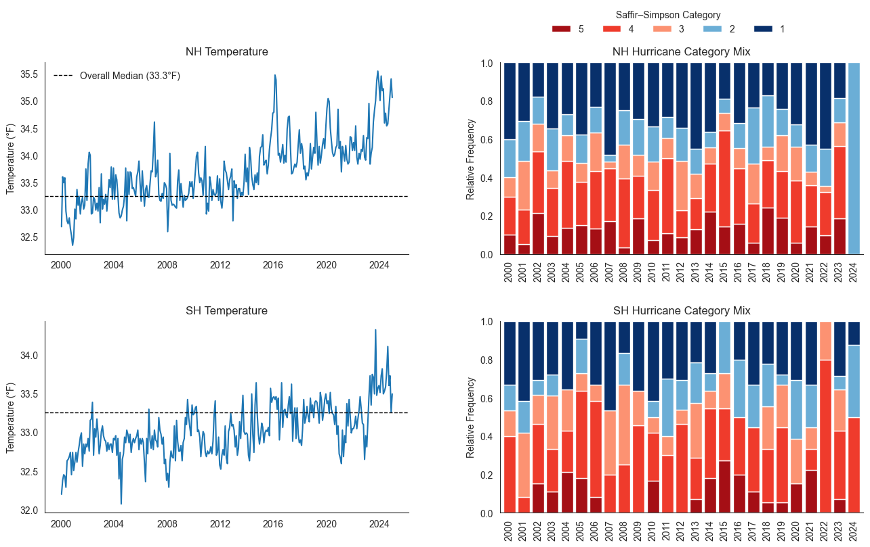
Hurricane Strength
Strong hurricanes spike during the warmest years.

Slide 9
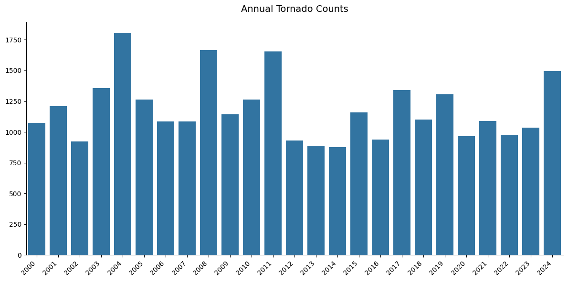
Tornado Counts in the United States
Similarly, tornado counts vary year to year, with no increase in occurences.

Slide 10
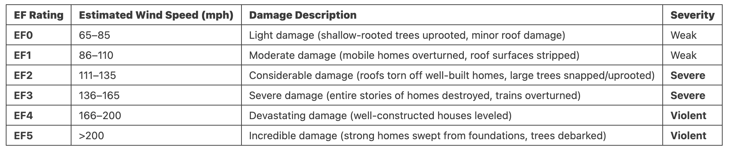
Tornado Classifications
Tornadoes categorized as EF1 or higher begin to cause moderate damage to homes.

Slide 11
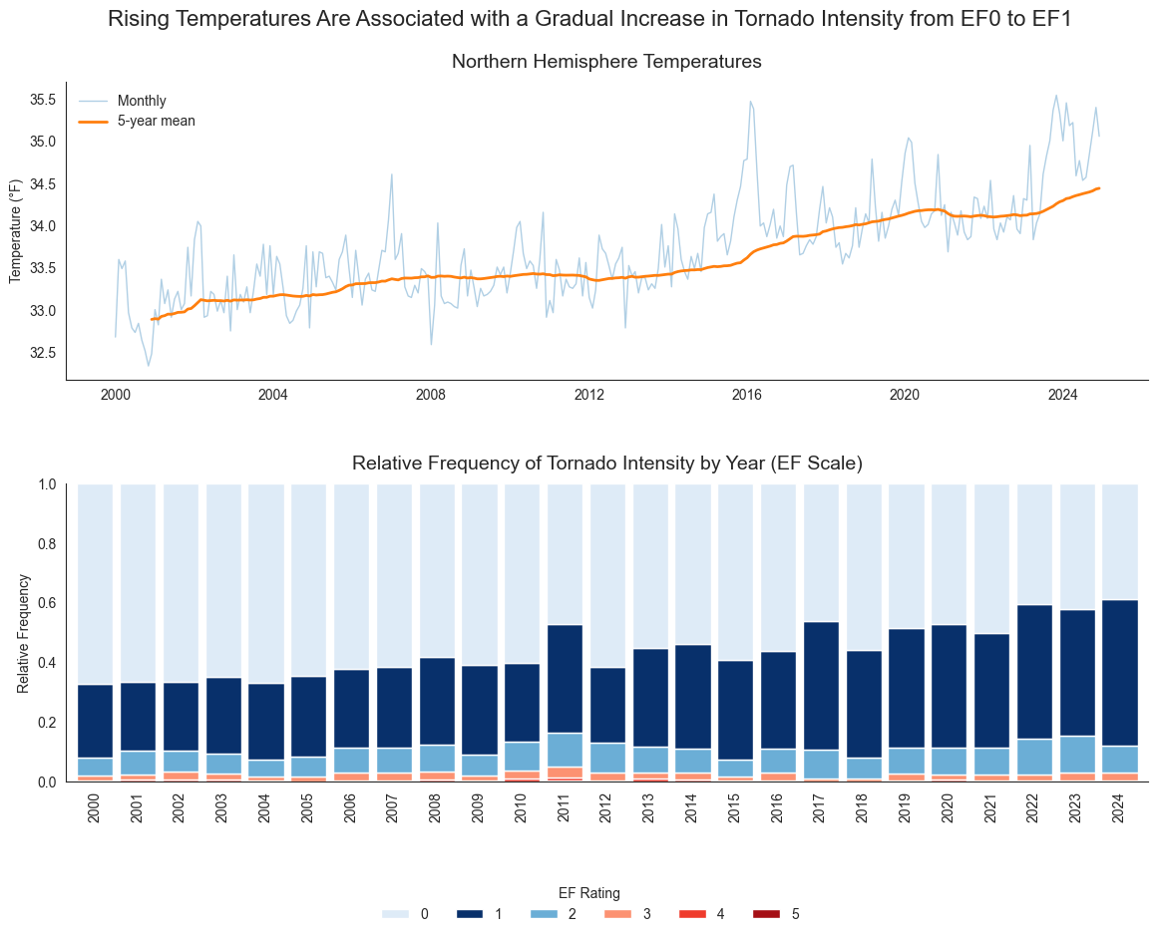
Temperature vs Tornado Strength
Warm years match stronger tornadoes.

Slide 12
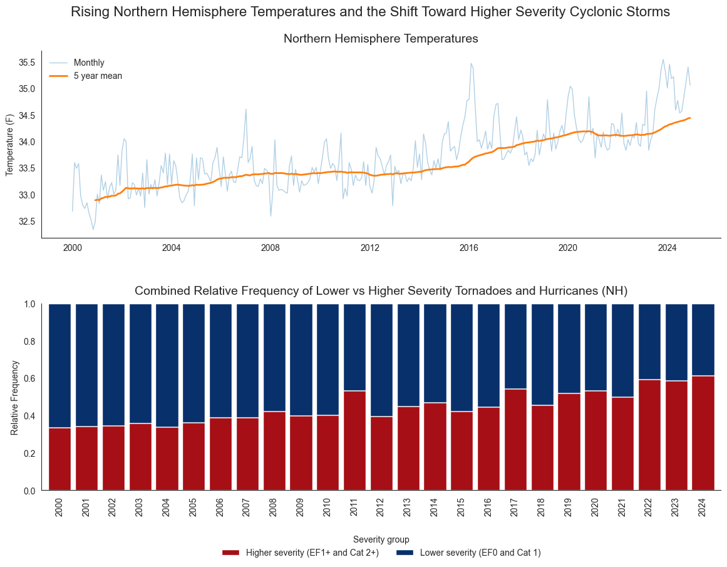
A warming Earth does not necessarily mean more cyclonic storms, but it often leads to more powerful storms as reflected in their categories.

Slide 13
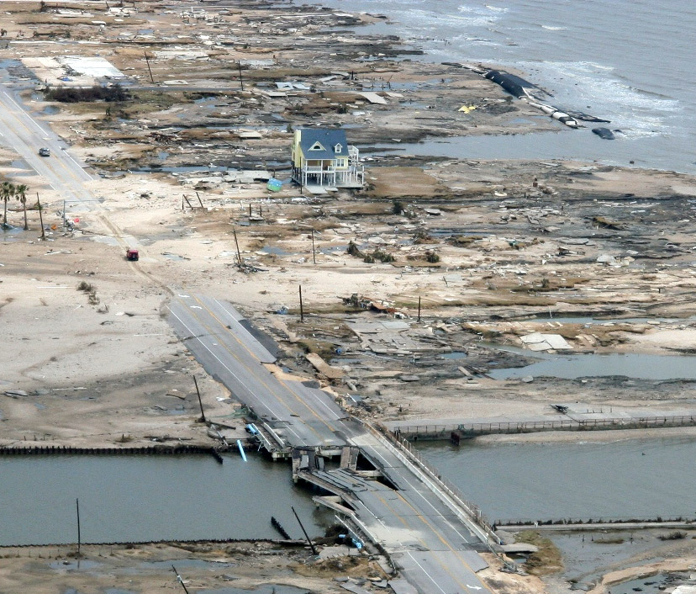
Regardless of political views on climate change, we should look for ways to strengthen our infrastructure so it can better withstand these storms.

